Slide 1
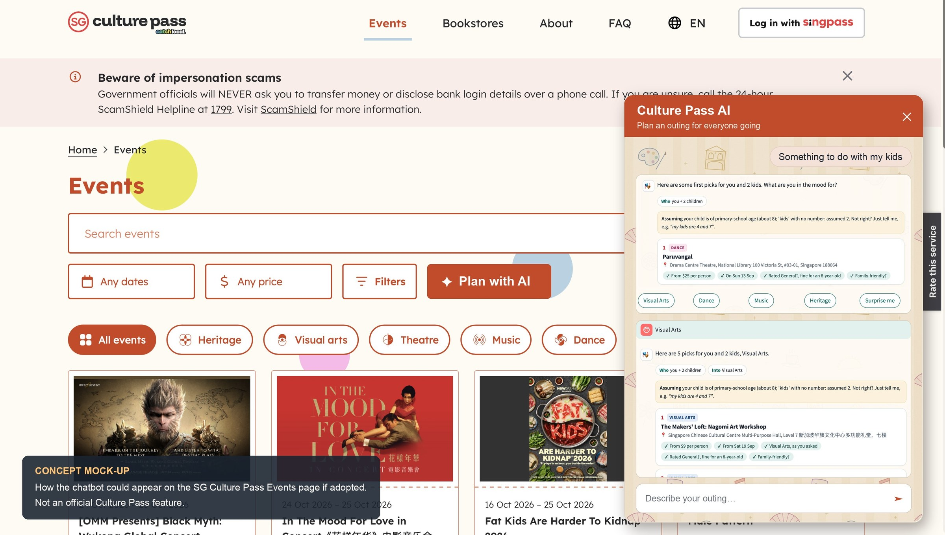
Notes:
Optional line while this is on screen: "This is a concept of how the chatbot could sit on the Culture Pass Events page if MCCY adopted it: a Plan with AI button beside the filters opens the same conversation you just saw. It is a mock-up, not an official Culture Pass feature."

